Slide 1

MACHINE
LEARNING

Slide 2
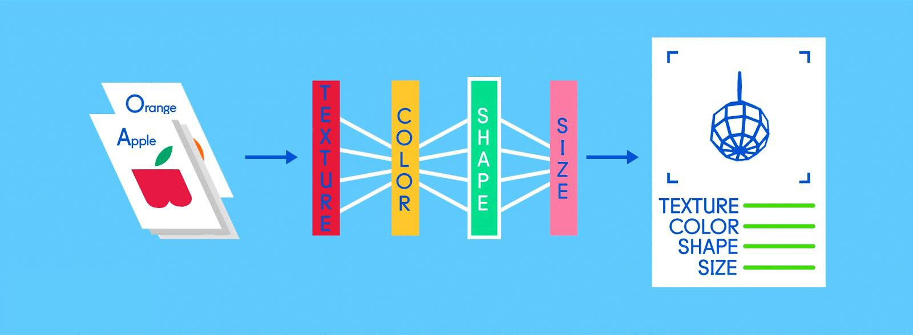
Machine Learning is the field of study that gives computers the capability to learn

Slide 3
EXAMPLE

Slide 4
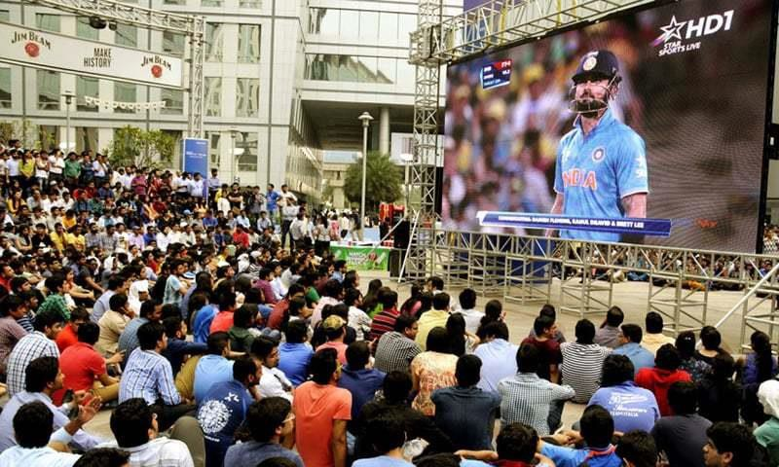
India needs 8 runs to win with 10 wickets in hand And 36 balls are remaining

Slide 5
India will either :
Win
OR
Loss

Slide 6

But the question is how can you be so sure ?
How can you do prediction ?
How can you be so confident about the outcome ?

Slide 7

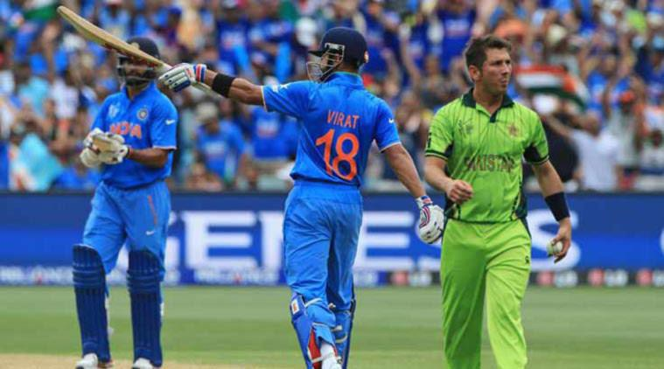

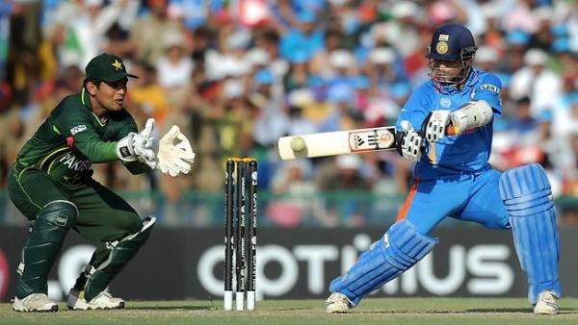

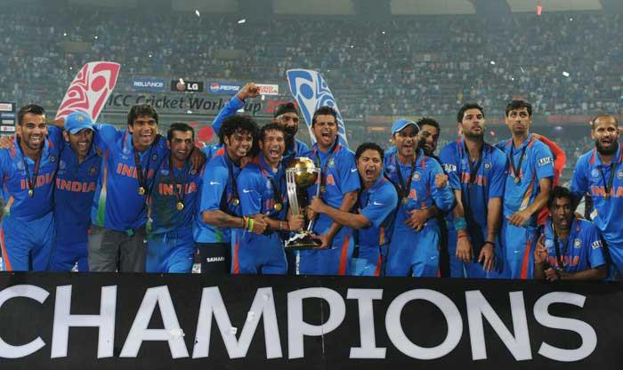
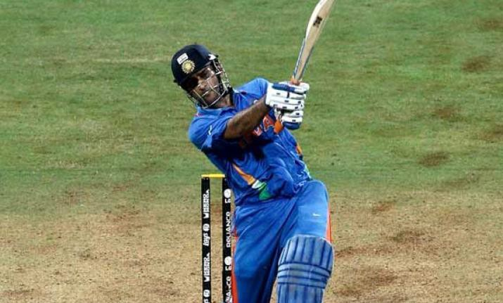

Slide 8


What if computer do this for you ?
May I Help You ?
To do that we need to
train our machines…
It means we need to share
our experiences with machines

Slide 9

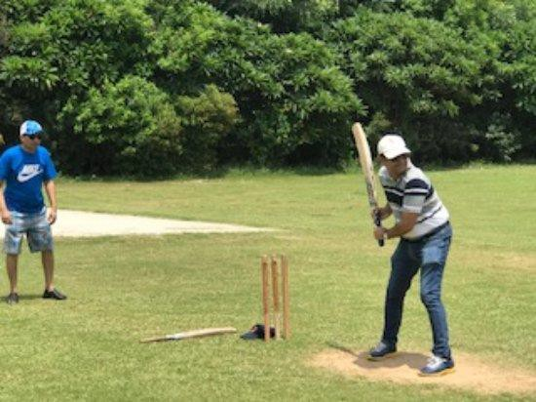
But wait, how a machine can learn from past experiences of human.
Because humans have memory in different form. We can learn from videos, images or playing the game by our self.

Slide 10

So how machines will learn, let’s see
Step – 1 : We will collect the data of previous matches in form of numbers. Step – 2 : Store that data in some file like excel or any other format.
Step – 3 : Now our machines can read that data easily.
So that’s how machines will get the data

Slide 11
Machine Learning
Reinforcement Learning
Semi-supervised Learning
Supervised Learning
{ Target Given }
Unsupervised Learning
{ No Target Given }
Regression
Classification
Clustering
Linear Regression
Logistic Regression
K-Means Clustering
K-Nearest Neighbors
Hierarchical Clustering
Naïve Bayes
Support Vector
Machines
Decision Tree

Slide 12
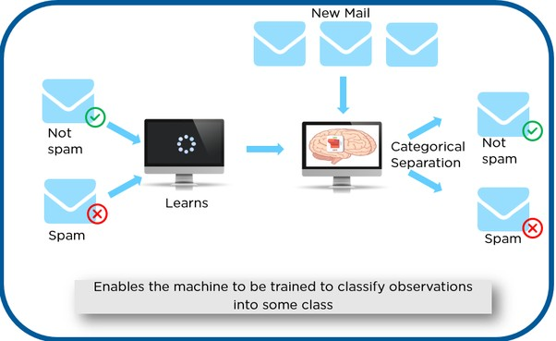
SUPERVISED LEARNING
Basically supervised learning is a learning in which we teach or train the machine using data which is well labeled
that means some data is already tagged with the correct answer.
After that, the machine is provided with a new set of examples(data) so that supervised learning algorithm analyses the training data(set of training examples) and produces a correct outcome from labeled data.

Slide 13
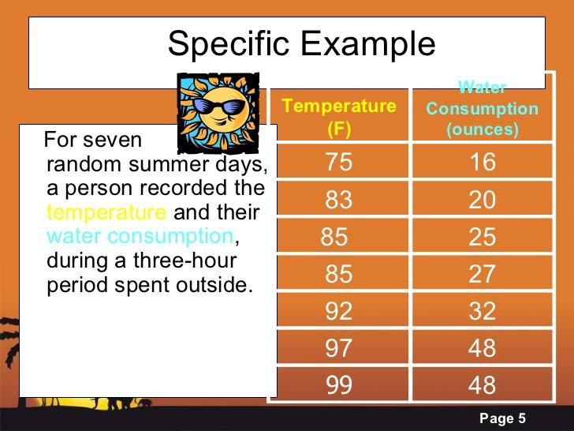
REGRESSION
Regression analysis is a subfield of supervised machine learning. It aims to model the relationship between a certain number of features and a continuous target variable. This technique is used for forecasting, time series modeling and finding the causal effect relationship between the variables.

Slide 14
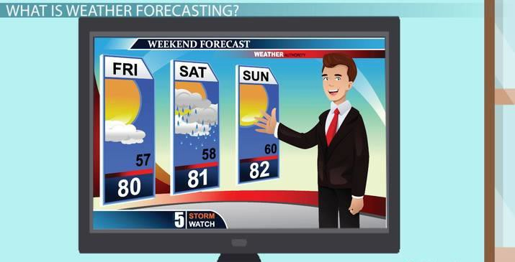


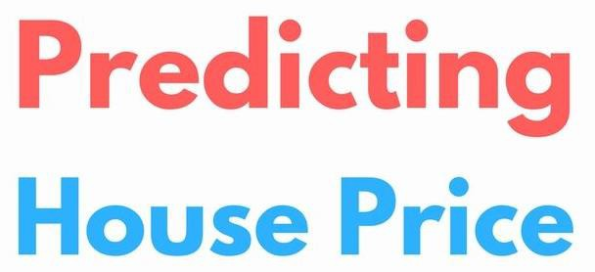
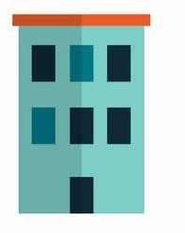


APPLICATIONS OF REGRESSION

Slide 15
Why Regression Analysis
Regression analysis estimates the relationship between two or more variables
Let’s say, you want to estimate growth in sales of a company based on current economic conditions. You have the recent company data which indicates that the growth in sales is around two and a half times the growth in the economy. Using this insight, we can predict future sales of the company based on current & past information.

Slide 16
Benefits of Regression Analysis
It indicates the significant relationships between dependent variable and independent variable.
It indicates the strength of impact of multiple independent variables on a dependent variable.

Slide 17
Linear Regression
It is one of the most widely known modeling technique.
In this technique, the dependent variable is continuous, independent variable(s) can be continuous or discrete and nature of regression line is linear.
Linear Regression establishes a relationship between dependent variable
(Y) and one or more independent variables (X) using a best fit straight line (also known as regression line).

Slide 18
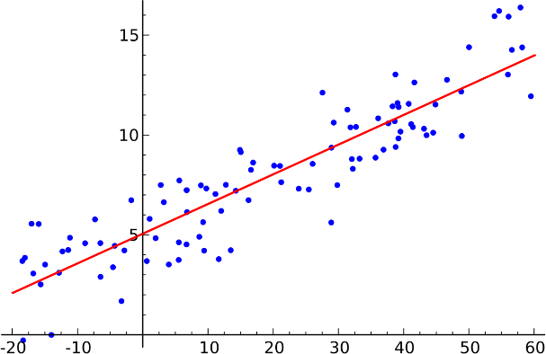
Linear Regression

Slide 19
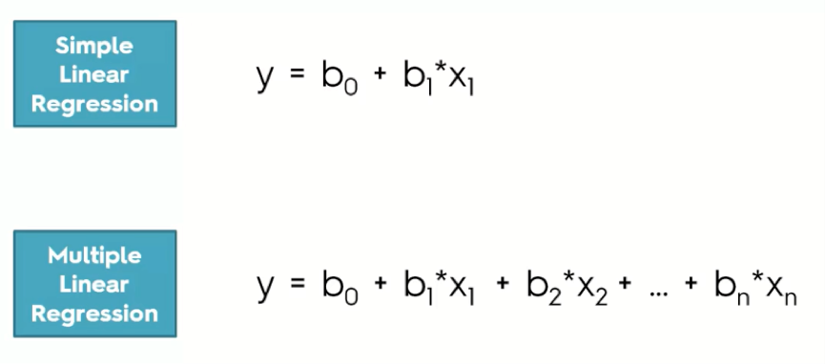
LINEAR REGRESSION MODELS
The difference between simple linear regression and multiple linear regression is that, multiple linear regression has (>1) independent variables, whereas simple linear regression has only 1 independent variable.

Slide 20
LINEAR REGRESSION MODELS
Simple Linear Regression
Ordinary Least Squares
Gradient Descent
Regularization

Slide 21
SIMPLE LINEAR REGRESSION
Simple linear regression is a statistical method that allows us to summarize and study relationships between two continuous (quantitative) variables:
One variable, denoted x, is regarded as the predictor, explanatory,
or independent variable.
The other variable, denoted y, is regarded as the response, outcome, or dependent variable.

Slide 22
SIMPLE LINEAR REGRESSION
With simple linear regression when we have a single input, we can use statistics to estimate the coefficients.
This requires that you calculate statistical properties from the data such as means, standard deviations, correlations and covariance. All of the data must be available to traverse and calculate statistics.

Slide 23
ORDINARY LEAST SQUARES
When we have more than one input we can use Ordinary Least Squares to estimate the values of the coefficients.
The Ordinary Least Squares procedure seeks to minimize the sum of the squared residuals.
This means that given a regression line through the data we calculate the distance from each data point to the regression line, square it, and sum all of the squared errors together. This is the quantity that ordinary least squares seeks to minimize.

Slide 24
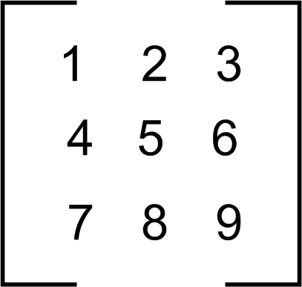
ORDINARY LEAST SQUARES
3. This approach treats the data as a matrix and uses linear algebra operations to estimate the optimal values for the coefficients. It means that all of the data must be available and you must have enough memory to fit the data and perform matrix operations.
OLS (ORDINARY LEAST
SQUARES)
Algebric Operations
(Add,Subtract,Product,Transpose etc)

Slide 25
GRADIENT DESCENT
When there are multiple inputs you can use a process of optimizing the values of the coefficients by iteratively minimizing the error of the model on your training data.
This operation is called Gradient Descent and works by starting with random values for each coefficient. The sum of the squared errors are calculated for each pair of input and output values.
A learning rate is used as a scale factor and the coefficients are updated in the direction towards minimizing the error. The process is repeated until a minimum sum squared error is achieved or no further improvement is possible.

Slide 26
GRADIENT DESCENT
Gradient descent is often taught using a linear regression model because it is relatively straightforward to understand.
In practice, it is useful when you have a very large dataset.

Slide 27
Regularization
There are extensions of the training of the linear model called regularization methods.
These seek to both minimize the sum of the squared error of the model on the training data (using ordinary least squares).
It also reduce the complexity of the model (like the number or absolute size of the sum of all coefficients in the model).

Slide 28
Regularization
Two popular examples of regularization procedures for linear regression are:
Lasso Regression: where Ordinary Least Squares is modified to also minimize the absolute
sum of the coefficients (called L1 regularization).
Ridge Regression: where Ordinary Least Squares is modified to also minimize the squared absolute sum of the coefficients (called L2 regularization).
These methods are effective to use when there is co-linearity in your input values and
ordinary least squares would over fit the training data.

Slide 29

Making Predictions

Slide 30
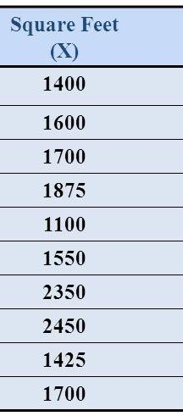
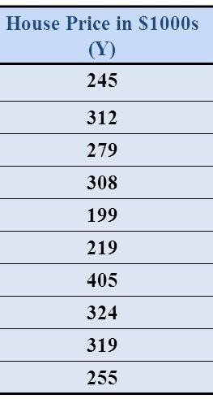
Lets understand the Procedure of Prediction by taking an Example
Making predictions is as simple as solving the equation for a specific set of inputs
Let’s make this concrete with an example. Imagine we are predicting weight (y) from height (x). Our linear regression model representation for this problem would be:
Y = B0 + B1 *X1
or
House_Price = B0 +B1 * Square_Feet

Slide 31
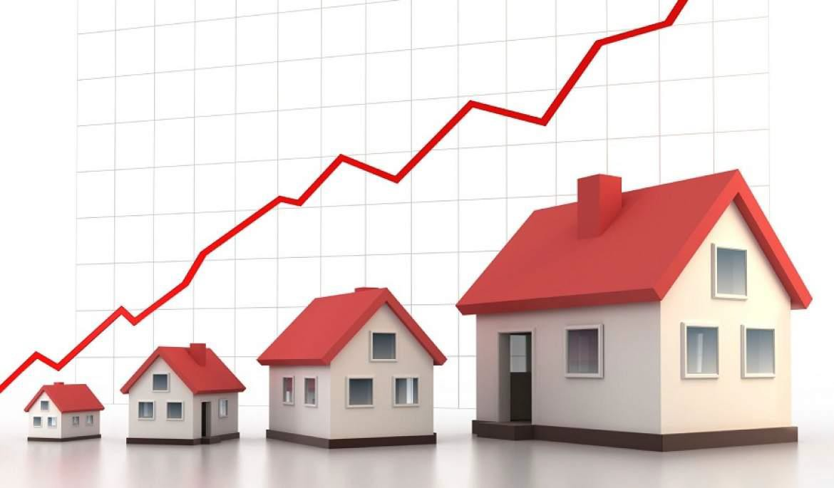
Making Predictions…
B0 is the bias coefficient and B1 is the coefficient for the House’s Square Feet column. We use a learning technique to find a good set of coefficient values. Once found, we can plug in different House’s Square Feet values to predict the Price of House.

Slide 32
Steps to find:
With simple linear regression we want to model our data as follows:
y = B0 + B1 * x
This is a line where y is the output variable we want to predict, x is the input variable we know and B0 and B1 are coefficients that we need to estimate that move the line around.

Slide 33
Steps Continues…
Technically, B0 is called the intercept because it determines where the line intercepts the y-axis.
The B1 term is called the slope because it defines the slope of the line.
The goal is to find the best estimates for the coefficients to minimize the errors in predicting y from x.

Slide 34
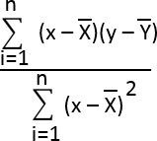
Steps Continues…
We can start off by estimating the value for B1 as:
B1 =
Where mean() is the average value for the variable in our dataset. The xi and yi refer to the fact that we need to repeat these calculations across all values in our dataset and i refers to the i’th value of x or y

Slide 35
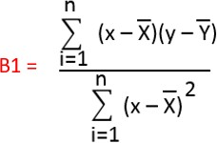
1. First of All, Calculate the Mean of X and Y
Square Feet(X) | House Price in $1000
1400 | 245
1600 | 312
1700 | 279
1875 | 308
1100 | 199
155 | 219
2350 | 405
2450 | 324
1425 | 319
1700 | 255
Now, Calculate B1(SLOPE) by using the formula
Mean = (Sum of all Observations)
(No. of Observations)
Mean(X) | Mean(Y)
1575.5 | 286.5

Slide 36
2. Then Calculate (xi-mean(x)) & (yi-mean(y))
Square Feet(X) | House Price in $1000
1400 | 245
1600 | 312
1700 | 279
1875 | 308
1100 | 199
155 | 219
2350 | 405
2450 | 324
1425 | 319
1700 | 255
X - Mean(X) | Y - Mean(X)
-175.5 | -1330.5
24.5 | -1263.5
124.5 | -1296.5
299.5 | -1267.5
-475.5 | -1376.5
-1420.5 | -1356.5
774.5 | -1170.5
874.5 | -1251.5
-150.5 | -1256.5
124.5 | -1320.5

Slide 37
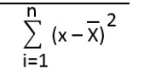
𝑥 − 𝑥
X - Mean(X) | Y - Mean(X)
-175.5 | -1330.5
24.5 | -1263.5
124.5 | -1296.5
299.5 | -1267.5
-475.5 | -1376.5
-1420.5 | -1356.5
774.5 | -1170.5
874.5 | -1251.5
-150.5 | -1256.5
124.5 | -1320.5
2
3. Then Calculate
(X- Mean(X)) ^ 2
30800.25
600.25
15500.25
89700.25
226100.25
2017820.25
599850.25
764750.25
22650.25
15500.25
3783272.5
3783272.5
Denominator

Slide 38
Numerator
X - Mean(X) | Y - Mean(X)
-175.5 | -1330.5
24.5 | -1263.5
124.5 | -1296.5
299.5 | -1267.5
-475.5 | -1376.5
-1420.5 | -1356.5
774.5 | -1170.5
874.5 | -1251.5
-150.5 | -1256.5
124.5 | -1320.5
3. We have Calculated the denominator , now calculate the numerator
(X-mean(X))*(Y-mean(Y))
233502.75
-30955.75
-161414.25
-379616.25
654525.75
1926908.25
-906552.25
-1094436.75
189103.25
-164402.25
Therefore, B1 = Numerator / Denominator B1(SLOPE) = 0.070484614
Numerator
266662.5

Slide 39
Steps Continues…
Estimating The Intercept (B0):
B0(Intercept) = mean(y) – B1 * mean(x)
Mean(X) | Mean(Y)
1575.5 | 286.5
We have found
B1(SLOPE) = 0.070484614
Therefore,
B0 = 286.5 – ( 0.070484614 * 1575.5) = 175.451490643

Slide 40





Making Predictions
We now have the coefficients for our simple linear regression equation. y_predict = B0 + B1 * X
450
400
350
300
250
200
150
100
50
0
y_Predict
175.4514914
274.1299503
288.226873
295.2753344
307.6101417
252.9845663
186.3766065
341.0903332
348.1387945
275.8920657
295.2753344
HOUSE_PRice
0
500
1000
1500
Square Feet Measurement of House
2000
2500
3000

Slide 41

House Price Prediction
450
400
350
300
250
200
150
100
50
0
HOUSE_PRice
0
500
1000 1500 2000
Square Feet Measurement of House
2500
3000

Slide 42
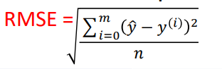
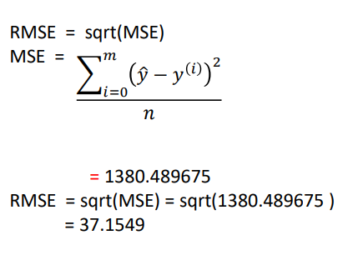
Estimating Error
We can calculate a error for our predictions called the Root Mean Squared Error or RMSE.
House Price in $1000(Y) | y_Predict
245 | 175.4514914
312 | 274.1299503
 | 288.226873
279
 | 295.2753344
308
 | 307.6101417
199
 | 252.9845663
219
 | 186.3766065
405
 | 341.0903332
324
 | 348.1387945
319
 | 275.8920657
255 | 295.2753344

Slide 43
Measuring Error with r-squared
How do we measure how well our line fits our data ?
R-squared ( coefficient of determination) measures:
The fraction of the total variation in Y that is captured by the model

Slide 44
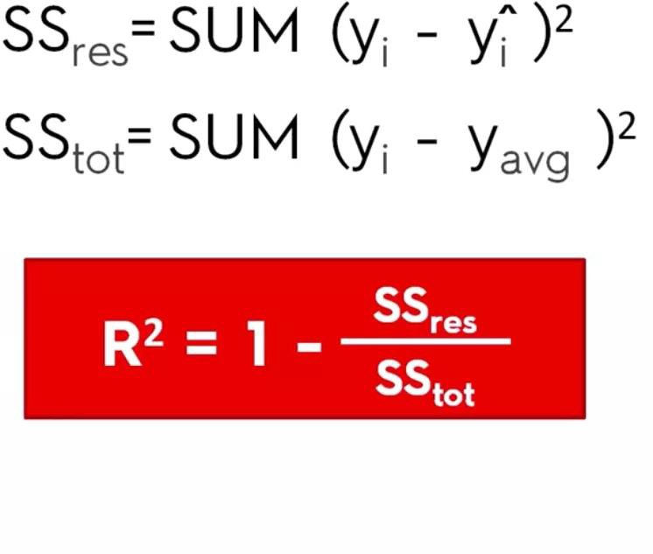
Computing r-squared

Slide 45
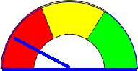


Interpreting r-squared
Ranges from 0 to 1
0 1
0 is bad (none of the variance is captured)
1 is good (all of the variance is captured).

Slide 46
R-squared and p-value
R-square value tells you how much variation is explained by your model.
So 0.1 R-square means that your model explains 10% of variation within the data. The greater R-square the better the model.
p-value tells you about the F statistic hypothesis testing of the "fit of the intercept-only model and your model are equal".
So if the p-value is less than the significance level (usually 0.05) then your model fits the data well.

Slide 47
R-squared and p-value
Thus you have four scenarios:
low R-square and low p-value (p-value <= 0.05)
low R-square and high p-value (p-value > 0.05)
high R-square and low p-value
high R-square and high p-value

Slide 48
Lets See the Linear Regression Implementation in Python

Slide 49
Multiple Linear Regression
Multiple Linear Regression is a type of Linear Regression when the input has multiple features(variables).
Model Representation
Similar to Simple Linear Regression, we have input variable(X) and output variable(Y). But the input variable has n features. Therefore, we can represent this linear model as follows

Slide 50
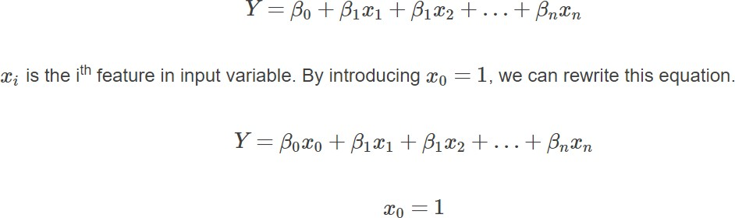
Multiple Linear Regression

Slide 51
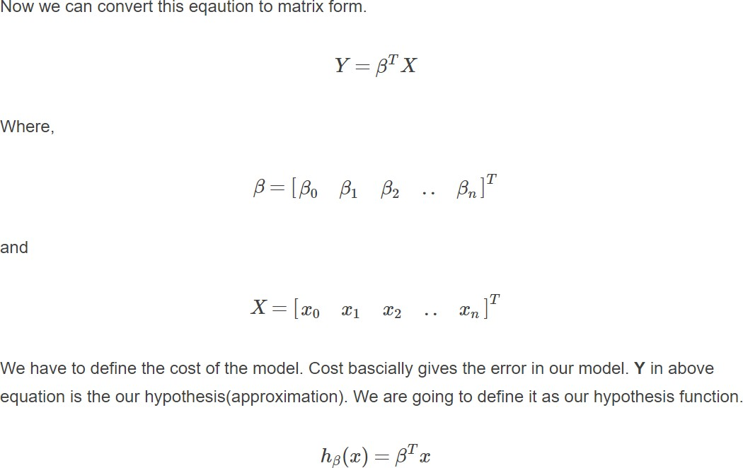
Multiple Linear Regression

Slide 52
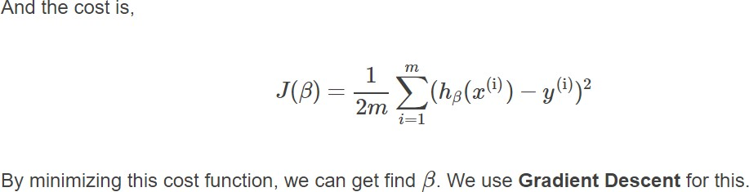
Multiple Linear Regression

Slide 53
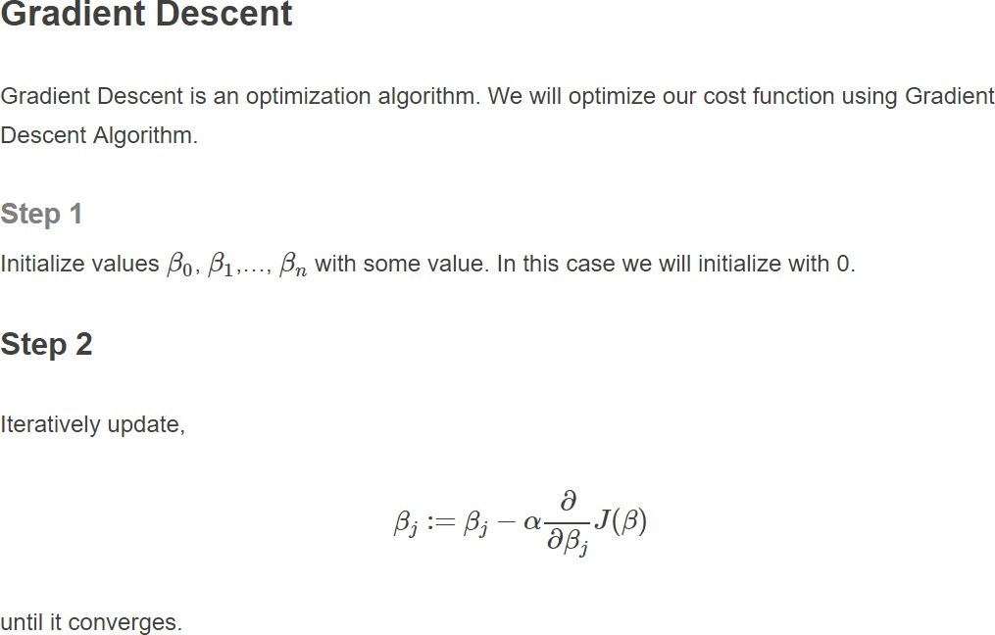
Multiple Linear Regression

Slide 54
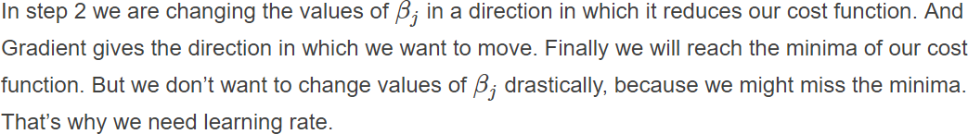
Multiple Linear Regression

Slide 55
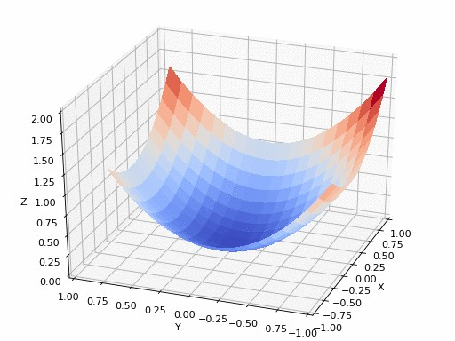
Multiple Linear Regression

Slide 56
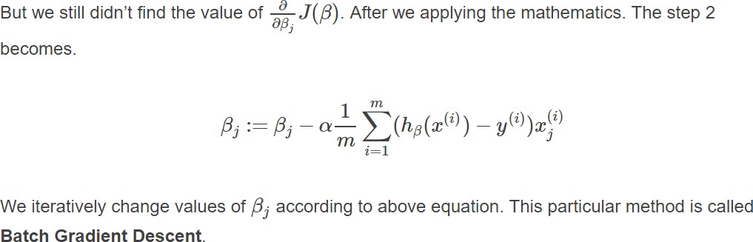
Multiple Linear Regression

Slide 57
Cost Function Derivative
Why does gradient descent use the derivative of the cost function? Finding the slope of the cost function at our current Ѳ value tells us two things.
The first is the direction to move theta in. When you look at the plot of a function, a positive slope means the function goes upward as you move right, so we want to move left in order to find the minimum. Similarly, a negative slope means the function goes downward towards the right, so we want to move right to find the minimum.

Slide 58
Cost Function Derivative
The second is how big of a step to take. If the slope is large we want to take a large step because we’re far from the minimum. If the slope is small we want to take a smaller step. Note in the example above how gradient descent takes increasingly smaller steps towards the minimum with each iteration.

Slide 59
The Learning Rate
The learning rate gives us some additional control over how large of steps we make.
Selecting the right learning rate is critical. If the learning rate is too large, you can overstep the minimum and even diverge. For example, think through what would happen if we use a learning rate of 2. Each iteration would take us farther away from the minimum!
The only concern with using too small of a learning rate is that you will need to run more iterations of gradient descent, increasing your training time.

Slide 60
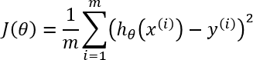
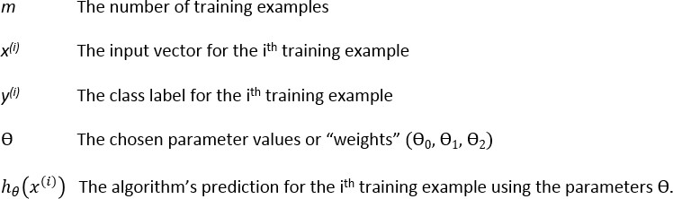
Gradient Descent of MSE
The cost function J for a particular choice of parameters Ѳ is the mean
squared error (MSE):

Slide 61
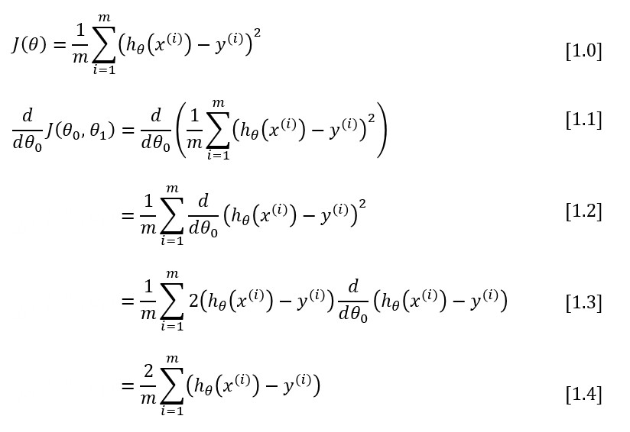
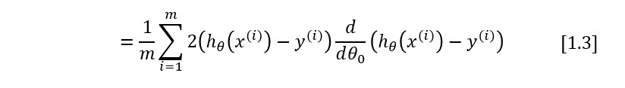
Gradient Descent of MSE

Slide 62
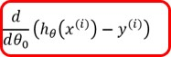
ℎ 𝑥 = 𝜃₀ + 𝑥𝜃₁
ⅆ
=
𝜃₀ + 𝜃₁𝑥 − 𝑦 ^{ⅈ}
ⅆ𝜃₀
= 1

Slide 63
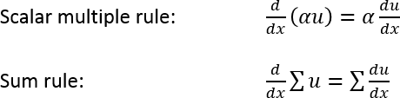
Gradient Descent of MSE
To move from equation [1.1] to [1.2], we need to apply two basic derivative rules:

Slide 64
Gradient Descent of MSE
Moving from [1.2] to [1.3], we apply both the power rule and the chain rule:

Slide 65
One Half Mean Squared Error
We multiply our MSE cost function by 1/2 so that when we take the derivative, the 2s cancel out. Multiplying the cost function by a scalar does not affect the location of its minimum, so we can get away with this.
Alternatively, you could think of this as folding the 2 into the learning rate. It makes sense to leave the 1/m term, though, because we want the same learning rate (alpha) to work for different training set sizes (m).

Slide 66
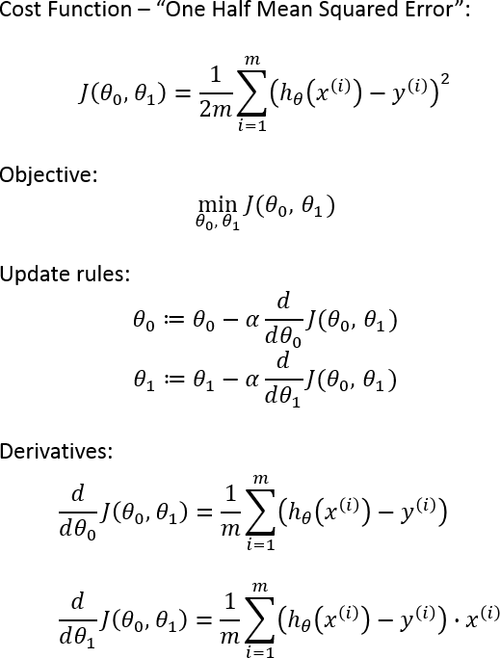

Slide 67
What is Logistic Regression?
Logistic regression is the appropriate regression analysis to conduct when the dependent variable is dichotomous (binary).
Like all regression analyses, the logistic regression is a predictive analysis.
Logistic regression is used to describe data and to explain the relationship between one dependent binary variable and one or more nominal, ordinal, interval or ratio-level independent variables.

Slide 68
Logistic Regression
➔Logistic Regression solves classification problems Usually we use this method for binary classification
For example: spam detection for emails, predicting if a customer will default on a loan ...
OUTCOME OF DEPENDENT VARIABLE IS DISCRETE !!!
➔it assigns probabilities to given outcomes
So the output is a probability that the given input belongs to a certain class

Slide 69





Logistic Regression
Applying Linear Regression for classification problem is not a good idea
paying back the debt
➔ it has values outside the [0,1] range
➔ it is sensitive to outliers
➔ we want to deal with probabilities as well
1 (YES)
0 (NO)
balance on
credit card
300
500
800
1000

Slide 70
Logistic Regression
Applying Linear Regression for classification problem is not a good idea
paying back the debt
➔ it has values outside the [0,1] range
➔ it is sensitive to outliers
➔ we want to deal with probabilities as well
1 (YES)
0 (NO)
balance on
credit card
300
500
800
1000

Slide 71

Logistic Regression
Applying Linear Regression for classification problem is not a good idea
paying back the debt
➔ it has values outside the [0,1] range
➔ it is sensitive to outliers
➔ we want to deal with probabilities as well
1 (YES)
0 (NO)
balance on
credit card
300
500
800
1000

Slide 72
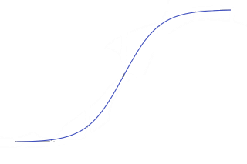
Logistic Regression
Applying Linear Regression for classification problem is not a good idea
paying back the debt
➔ it has values outside the [0,1] range
➔ it is sensible to outliers
➔ we want to deal with probabilities as well
1 (YES)
0 (NO)
balance on
credit card
300
500
800
1000

Slide 73
Logistic Regression
We have to deal with the sigmoid-function
1
f(x) =
X = b0 + b1x1+b2x2+--------bnxn
1 + e
-x
➔ we are able to solve the problems we have discussed
➔ it has a value between [0,1]
➔ it can be interpreted as probability

Slide 74
Logistic Regression
We have to deal with the sigmoid-function
the probability of default given x balance
p(x) = P(y=1|x=balance)
1
p(x) =
1 + e
- (b₀+ b₁* x)
these are the model parameters b₀ and b₁
There are several ways to fit the model
➔ gradient descent
➔ maximum-likelihood method

Slide 75
Logistic Regression
We have to deal with the sigmoid-function
p(x)
1 - p(x)
ln (
) = b₀ + b₁ x
„logit transformation”
➔ the point of the logit transformation is to make it linear: so logistic regression is a linear regression on the logit transformation
➔ how to fit the b parameters: with gradient descent and maximum-likelihood method It is a generalized linear model: not because the estimated probability of the response is linear but
because the logit of the estimated probability response is a linear function of the parameters

Slide 76
Logistic Regression
SIMPLE LOGISTIC REGRESSION
MULTINOMIAL LOGISTIC REGRESSION
➔ we have just a single x parameter
➔ we have multiple x parameters
➔ For example: balance on credit card
➔ For example: balance on credit card, age,
gender, demographics, loan to income ratio ...
1
1
p(x) =
p(x) =
- (b ₀+ b ₁* x)
- (b ₀+ b ₁* x ₁+ ... + b_{n}x_{n})
1 + e 1 + e
Usually we use logistic regression for binary classification: so with 2 output classes For example: email is spam or not, client is sick or healthy ...

Slide 77
Logistic Regression – Maximum Likelihood
Maximum Likelihood Estimation is a method of estimating the parameters of a statistical model
given observations, by finding the parameter values that maximize the likelihood of
making the observations given the parameters
➔ the method is based on a likelihood-function
log likelihood-function
l(β,x) =
ln L(β,x)
likelihood-function
The aim is the same as we have seen for Linear Regression: we are after the
optimal β values that maximize the likelihood-function
β such that { arg max l(β,x)}
β

Slide 78
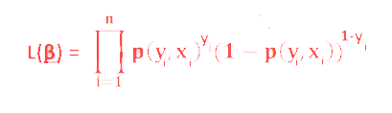
Logistic Regression – Maximum Likelihood
Maximum Likelihood Estimation is a method of estimating the parameters of a statistical model
given observations, by finding the parameter values that maximize the likelihood of
making the observations given the parameters
likelihood-function for
logistic regression
1
p(y ,x ) =
i i
1 + e
- (x’_{i} * β )
➔ this estimate is usually obtained by using the iterative algorithm Newton-Raphson method

Slide 79
LINEAR V/s LOGISTIC REGRESSION
CONTINUOUS VARIABLES
CATEGORICAL VARIABLES
SOLVES REGRESSION
PROBLEMS
SOLVES CLASSIFICATION
PROBLEMS
STRAIGHT LINE
S - CURVE

Slide 80
Confusion Matrix
PREDICTED
0
1
122 | 12
34 | 89
0
ACTUAL
1
Describes the performance of a classification model
➔ diagonal elements: the correct classifications
➔ off-diagonals: incorrect predictions

Slide 81
Cross Validation
TRAINING DATASET
TEST DATASET
~ 70% of the original dataset ~ 30% of the original dataset
We fit the model to the training dataset: then we test the model on the test dataset
~ we only have information how the model performs to our in-sample data but we would like to see the accuracy when dealing with new data
OVERFITTING: model has trained „too well” on the training dataset
➔ it means it is very accurate on the training dataset but yields
poor results on the test set (due to too complex models)
x₂
➔ the model learns the „noise” instead of the actual relationships
between the variables in the data
(of course this noise is not present in the test set...)
x₁

Slide 82
Cross Validation
TRAINING DATASET
TEST DATASET
~ 70% of the original dataset ~ 30% of the original dataset
We fit the model to the training dataset: then we test the model on the test dataset
~ we only have information how the model preforms to our in-sample data but we would like to see the accuracy when dealing with new data
UNDERFITTING: model has not been fitted well to the training dataset
➔ misses the trends in the training dataset
➔ this is usually the case when we use too simple models for the problem
x₂
x₁

Slide 83
Cross Validation
K-Folds Cross Validation
➔ helps to avoid underfitting as well as overfitting
(help to avoid overfitting more than underfitting)
➔ the aim is to be able to generalize the model to new datasets with same accuracy
➔ we use all the data for training !!!
TRAINING DATASET

Slide 84
Cross Validation
K-Folds Cross Validation
➔ helps to avoid underfitting as well as overfitting
(help to avoid overfitting more than underfitting)
➔ the aim is to be able to generalize the model to new datasets with same accuracy
➔ we use all the data for training !!!
Let’s split the data into k folds (for example k=5)

Slide 85
Cross Validation
K-Folds Cross Validation
➔ helps to avoid underfitting as well as overfitting
(help to avoid overfitting more than underfitting)
➔ the aim is to be able to generalize the model to new datasets with same accuracy
➔ we use all the data for training !!!
Let’s split the data into k folds (for example k=5)
➔ we run k separate learning experiments
k-1 folds for training and 1 fold for the test set
➔ we average the results from this k experiments

Slide 86
Cross Validation
K-Folds Cross Validation
➔ helps to avoid underfitting as well as overfitting
(help to avoid overfitting more than underfitting)
➔ the aim is to be able to generalize the model to new datasets with same accuracy
➔ we use all the data for training !!!
Let’s split the data into k folds (for example k=5)
➔ we run k separate learning experiments
k-1 folds for training and 1 fold for the test set
➔ we average the results from this k experiments

Slide 87
Cross Validation
K-Folds Cross Validation
➔ helps to avoid underfitting as well as overfitting
(help to avoid overfitting more than underfitting)
➔ the aim is to be able to generalize the model to new datasets with same accuracy
➔ we use all the data for training !!!
Let’s split the data into k folds (for example k=5)
➔ we run k separate learning experiments
k-1 folds for training and 1 fold for the test set
➔ we average the results from this k experiments

Slide 88
Cross Validation
K-Folds Cross Validation
➔ helps to avoid underfitting as well as overfitting
(help to avoid overfitting more than underfitting)
➔ the aim is to be able to generalize the model to new datasets with same accuracy
➔ we use all the data for training !!!
Let’s split the data into k folds (for example k=5)
➔ we run k separate learning experiments
k-1 folds for training and 1 fold for the test set
➔ we average the results from this k experiments

Slide 89
Cross Validation
K-Folds Cross Validation
➔ helps to avoid underfitting as well as overfitting
(help to avoid overfitting more than underfitting)
➔ the aim is to be able to generalize the model to new datasets with same accuracy
➔ we use all the data for training !!!
Let’s split the data into k folds (for example k=5)
➔ we run k separate learning experiments
k-1 folds for training and 1 fold for the test set
➔ we average the results from this k experiments
ADVANTAGE: all observations are used for both training and validation
+ each observations are used for validation exactly once

Slide 90
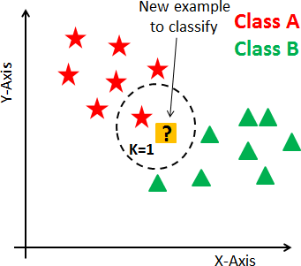
K-Nearest Neighbor Classifier
K-Nearest Neighbors is one of the most basic yet essential classification algorithms in Machine Learning.
It belongs to the supervised learning domain.
It finds intense application in pattern recognition, data mining and intrusion
detection

Slide 91
K-Nearest Neighbor Classifier
K-Nearest Neighbors (kNN) classifiers can classify examples by assigning them the class of the most similar
labeled examples.
very simple BUT extremely powerful algorithm !!!
kNN is well suited for classification tasks where the relationship between the features are very complex and
hard to understand.
we have a training dataset ➔ examples that are classified into several categories.
we have a new example (with the same number of features as the training data) ➔ kNN algorithm identifies
k elements in the training dataset that are the „nearest” in similarity.
the unlabeled test example is assigned to the class of the majority of the k nearest neighbors.

Slide 92
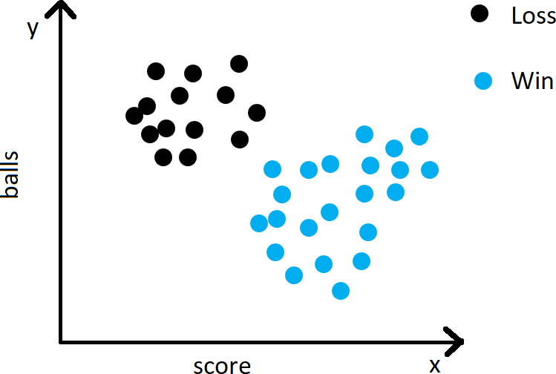

Slide 94

New Input

Slide 95

New Input

Slide 96
New Input

Slide 97
New Input

Slide 98
New Input

Slide 99
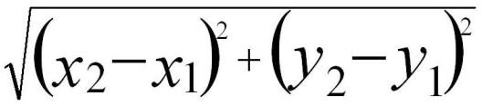
K-NEAREST NEIGHBORS
New Input

Slide 100
K-Nearest Neighbor Classifier
Movie Name
Users Review
Critics Review
type
Avengers :EndGame
10
9
Action
Housefull
1
4
Comedy
MI:Fallout
10
8
Action
MS Dhoni
7
10
Drama
Guardians of Galaxy
8
5
Thriller

Slide 101
K-Nearest Neighbor Classifier
 | Movie Name | Users Review | Critics Review | type
Avengers :EndGame Housefull MI:Fallout MS Dhoni Guardians of Galaxy |  | 10 1 10 7 8 | 9 4 8 10 5 | Action Comedy Action Drama Thriller
Total Dhamaal |  | 7 | 4 | ?
NEW INPUT

Slide 102





Action Drama
12
MS Dhoni
10
The Flash
Avengers:EndGame
Thriller
The Expendables:3
Comedy
8
Superman
MI: FallOUT
CRITICS RATING
SpiderMan
6
Guardians of Galaxy
Housefull
Iron Man : 3
4
Ghost Busters
2
0
0
2
4
6
USERS RATING
8
10
12

Slide 103



12
Action Drama
MS Dhoni
10
The Flash
Avengers:EndGame
Thriller
The Expendables:3
Comedy
8
Superman
MI: FallOUT
CRITICS RATING
SpiderMan
6
Guardians of Galaxy
Housefull
Iron Man : 3
4
Ghost Busters
Total Dhamaal
2
New Input
0
0
2
4
6
USERS RATING
8
10
12

Slide 104
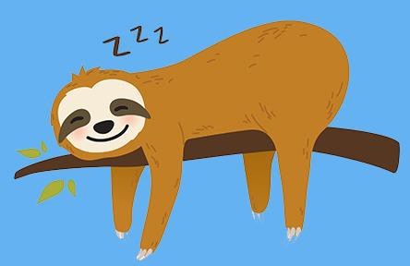
K-Nearest Neighbor Classifier
lazy learners does not learn anything !!!
we just store the training data: training is very fast (because there is no training at all) BUT making the prediction is rather slow (calculating the distances)
WE DO NOT BUILD A MODEL !!!
this is a non-parametric learning: no parameters are to be learned about the data Linear Regression / Logistic Regression: have to learn the β parameters either
with gradient descent or with maximum likelihood method

Slide 105
K-Nearest Neighbor Classifier
Movie Name Users Review
Avengers :EndGame 10
Housefull 1
MI:Fallout 10
MS Dhoni 7
Guardians of Galaxy 8
Total Dhamaal 7
Critics Review
type
9
Action
4
Comedy
8
Action
10
Drama
5
Thriller
4
?
(𝟕 − 𝟖)^{𝟐}+(𝟒 − 𝟓)^{𝟐} = 1.414
dist(Total Dhamaal,Guardians of Galaxy) =

Slide 106
K-Nearest Neighbor Classifier
dist(Total Dhamaal, Avengers:Endgame) =
dist(Total Dhamaal,HouseFull) =
dist(Total Dhamaal, MI:FallOut) =
dist(Total Dhamaal,MS Dhoni) =
dist(Total Dhamaal,Guardians of Galaxy) =
(𝟕 − 𝟏𝟎)^{𝟐}+(𝟒 − 𝟗)^{𝟐} = 5.83
(𝟕 − 𝟏)^{𝟐}+(𝟒 − 𝟒)^{𝟐} = 6
(𝟕 − 𝟏𝟎)^{𝟐}+(𝟒 − 𝟖)^{𝟐} = 5
(𝟕 − 𝟕)^{𝟐}+(𝟒 − 𝟏𝟎)^{𝟐} = 6
(𝟕 − 𝟖)^{𝟐}+(𝟒 − 𝟓)^{𝟐} = 1.414

Slide 107
K-Nearest Neighbor Classifier
dist(Total Dhamaal, Avengers:Endgame) =
(𝟕 − 𝟏𝟎)^{𝟐}+(𝟒 − 𝟗)^{𝟐} = 5.83
dist(Total Dhamaal,HouseFull) =
(𝟕 − 𝟏)^{𝟐}+(𝟒 − 𝟒)^{𝟐} = 6
dist(Total Dhamaal, MI:FallOut) =
(𝟕 − 𝟏𝟎)^{𝟐}+(𝟒 − 𝟖)^{𝟐} = 5
(𝟕 − 𝟕)^{𝟐}+(𝟒 − 𝟏𝟎)^{𝟐} = 6
dist(Total Dhamaal,MS Dhoni) =
dist(Total Dhamaal,Guardians of Galaxy) =
(𝟕 − 𝟖)^{𝟐}+(𝟒 − 𝟓)^{𝟐} = 1.414
k=1
we consider the smallest distance: Guardians of Galaxy
k=2
we consider the 2 smallest distances:Guardians of Galaxy and Avengers:EndGAme
50%-50% that Total Dhamaal is a Action or a Thriller Movie.
k=3
we consider the 3 smallest distances: Guardians of Galaxy ,Avengers: EndGame, MI:FallOut So Total Dhamaal appears to be Action Movie !!!

Slide 108
K-Nearest Neighbor Classifier
HOW TO CHOOSE THE OPTIMAL K VALUE
deciding how many neighbors to use for kNN ➔ determines how well the model will generalize and work on other datasets
k is small ➔ noisy data or outliers have a huge impact on our classifier ...
this is called „underfitting”
k is large ➔ the classifier has the tendency to predict the majority class
regardless of which neighbors are nearest ... this is called „overfitting”

Slide 109
K-Nearest Neighbor Classifier
dist(x,y) =
(𝒙 − 𝒚 )^{𝟐}+(𝒙 − 𝒚 )^{𝟐}+ ⋯ +(𝒙 − 𝒚 )^{𝟐}
1 2
2
n n
1
Distance Formula

Slide 110
K-Nearest Neighbor Classifier
HOW TO CHOOSE THE OPTIMAL K VALUE
deciding how many neighbors to use for kNN ➔ determines how well the model will generalize and work on other datasets
k is small ➔ noisy data or outliers have a huge impact on our classifier ...
this is called „underfitting”
k is large ➔ the classifier has the tendency to predict the majority class
regardless of which neighbors are nearest ... this is called „overfitting”

Slide 111
Normalization
Normalization is a technique often applied as part of data preparation for machine learning.
The goal of normalization is to change the values of numeric columns in the dataset to a common scale, without distorting differences in the ranges of values.
For machine learning, every dataset does not require normalization. It is required only when features have different ranges.

Slide 112
Normalization
min-max normalization
z-transformation

Slide 113
Normalization
MIN-MAX NORMALIZATION
➔ this process transforms a feature such that all of its values fall in a range between 0 and 1
➔ normalized feature values can be interpreted as indicating how far, from 0%
to 100%, the original value fall along the range between the original minima and
maxima
X =
𝑿 −𝐦𝐢𝐧(𝑿)
new
𝐦𝐚𝐱 𝑿 −𝐦𝐢𝐧(𝑿)

Slide 114
Normalization
Z-SCORE NORMALIZATION (STANDARDIZATION)
➔ it is a way of normalizing the dataset as well: the algorithm
uses mean and standard deviation to do so
X =
𝑿 −𝐦𝐞𝐚𝐧(𝑿)
new 𝑺𝒕𝒂𝒏𝒅𝒂𝒓𝒅𝑫𝒆𝒗𝒊𝒂𝒕𝒊𝒐𝒏(𝑿)
For Principle Component Analysis we prefer using z-score normalization
~ but for image processing: pixel intensities have to be normalized to fit within a certain range + neural networks requires data that on a 0-1 scale

Slide 115
Naive Bayes Classifier
very efficient supervised learning algorithm
it scales well even in high dimensions !!!
it is able to compete with SVM or random forest classifiers
it is able to make good predictions even when the training data is relatively small
Why is it naive?
The naive assumption is that every pair of features are independent

Slide 116
Naive Bayes Classifier
Naive means there is a strong independence assumptions between the given features
For example: a fruit can be considered to be an apple if it is red, rounded and about 8cm in diameter
~ Naive Bayes Classifier considers each of these features contribute independently
to the probability that this fruit is an apple
(do not care about the correlation between color, roundness and diameter)

Slide 117
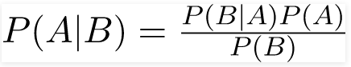
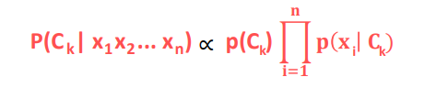
Naive Bayes Classifier
ABSTRACT MATHEMATICAL APPROACH
x are the features
P(C _{k}| x₁ x₂ ... x_{n})
this model relies heavily on
conditional probability
C is the possible
outcome of k classes
𝐩 𝐂_{k}
𝐩 𝐱₋
𝐂_{k})
this is the Bayes theorem, we can decompose the
conditional probability
P(C _{k}| x ₁x₂ ... x_{n}) =
𝐩(𝐱)
-
P( x₁ x₂... x_{n}| C_{k}) = P(x₁| C_{k}) P(x₂| C_{k}) ... P(x_{n}| C_{k})
INDEPENDENT FEATURES !!!

Slide 118
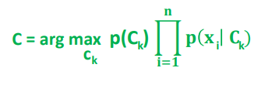
Naive Bayes Classifier
ABSTRACT MATHEMATICAL APPROACH
If we assume the features are independent we can come up with a powerful probability-based classification algorithm
➔ we have to choose the C class with the highest probability
K
„Naive Bayes Classifier”

Slide 119
Naive Bayes Classifier
ADVANTAGES
➔ relatively simple to understand
➔ it can be trained on small datasets as well
➔ it is a fast approach
➔ it is not sensitive to irrelevant features
DISADVANTAGES
➔it assumes every feature is independent: of course it is not always true !!!

Slide 120
Naive Bayes Classifier
Why is it so powerful for text classification?
The two assumptions of Naive Bayes Classifier:
➔ the probability of occurrence of any word given the class label
is independent of the probability of occurrence of any other word given that label
➔ the probability of occurrence of a word in a document is independent of the
location of that word within the document
It is the same assumption of bag-of-words model: documents are just a bunch of words thrown together
THESE ASSUMPTIONS ARE TRUE FOR TEXT CLASSIFICATION !!!

Slide 121
Naive Bayes Classifier

Slide 122
Naive Bayes Classifier
?

Slide 123
Naive Bayes Classifier
P(yellow) =
𝟕
𝟏𝟕
P(green) =
𝟏𝟎
𝟏𝟕
?

Slide 124
Naive Bayes Classifier
P(yellow) =
𝟕
𝟏𝟕
P(green) =
𝟏𝟎
𝟏𝟕
?

Slide 125
Naive Bayes Classifier
P(yellow) =
𝟕
𝟏𝟕
P’(? | green) =
𝟑
𝟏𝟎
P(green) =
𝟏𝟎
𝟏𝟕
P’(? | yellow) =
𝟏
𝟕
?

Slide 126
Naive Bayes Classifier
P(yellow) =
𝟕
𝟏𝟕
P’(? | green) =
𝟑
𝟏𝟎
P(green) =
𝟏𝟎
𝟏𝟕
P’(? | yellow) =
𝟏
𝟕
?
posterior probability
𝟏𝟎 𝟑
𝟑𝟎
P’’(? is green ) = P(green) * P’(? | green) = *
=
𝟏𝟕 𝟏𝟎
𝟏𝟕𝟎
posterior probability
𝟕 𝟏
𝟕
P’’(? is yellow ) = P(yellow) * P’(? | yellow) = * =
𝟏𝟕 𝟕
𝟏𝟏𝟗

Slide 127
Naive Bayes Classifier
P(yellow) =
𝟕
𝟏𝟕
P’(? | green) =
𝟑
𝟏𝟎
P(green) =
𝟏𝟎
𝟏𝟕
P’(? | yellow) =
𝟏
𝟕
?
posterior probability
𝟏𝟎 𝟑
𝟑𝟎
P’’(? is green ) = P(green) * P’(? | green) = *
=
𝟏𝟕 𝟏𝟎
𝟏𝟕𝟎
posterior probability
𝟕 𝟏
𝟕
P’’(? is yellow ) = P(yellow) * P’(? | yellow) = * =
𝟏𝟕 𝟕
𝟏𝟏𝟗

Slide 128
Decision Trees
Decision Tree is a type of supervised learning approaches: mostly used in classification problems but it can be used for regression as well
~ works fine for both categorical variables and continuous input as well
➔ very similar to search trees
➔ split the data/population into two or more homogeneous sets
based on significant splitter in input variables

Slide 129
For example:
we have a single feature x, the number of hours a student spent with studying Want to predict the y probability of passing the exam
we split on x
Categorical Variable Decision Tree:
➔ categorical target variable such as yes/no or fail/pass
x < 5
x > 5
Continuous Variable Decision Tree:
➔ continuous target variable: such as for regression
FAIL
PASS

Slide 130
Decision Trees
root node: represent the entire dataset/population and this further gets divided into several subsets
~ root node corresponds to the best predictor
decision node: the algorithm splits the node into sub-nodes based on given
feature in the dataset
leaf nodes: with no children
~ the values are what we are after
HOW TO DECIDE WHAT NODES (FEATURES) ARE IMPORTANT?
WHAT SHOULD BE THE ROOT NODE?

Slide 131
Decision Trees
Decision Tree classifier accuracy depends heavily on splits Hot to construct the tree? What are the nodes?
There are several algorithms for this problem:
Gini Index Approach
Calculating the information entropy (ID3 algorithm or C4.5 approach)
algorithm based on variance reduction

Slide 132
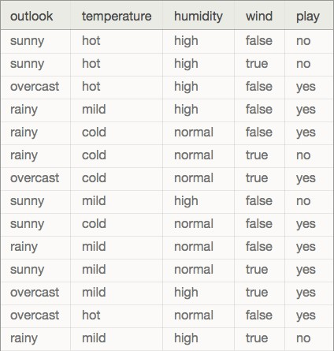
Decision Trees
We are dealing with categorical variables (predictors)
or features: outlook, temperature, humidity, wind
we want to predict whether to play
golf or not (play is he target variable)

Slide 133
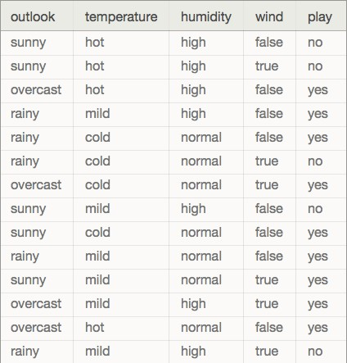
Decision Trees
OUTLOOK
SUNNY
OVERCAST
RAINY
WINDY
YES
HUMIDITY
TRUE
FALSE
HIGH
NORMAL
YES
NO
NO
YES

Slide 134
Decision Trees
Usually ID3 algorithm is used to build the decision tree:
~ it is a top-down greedy search of possible branches
➔ it uses entropy and information gain to build the tree
The H(X) Shannon-entropy of a dicrete random variable X with possible values
x₁x ₂ ... x_{n} and probability mass function P(X) is defined as:
𝐧
H(X) = - ෍ 𝐏 𝐱_{i}
𝐢=𝟏
𝐥𝐨𝐠 𝐏(𝐱 )
2 i
For completely homogoeneous dataset (all TRUE or all FALSE values): entropy is 0
If the dataset is equally divided (same amount of TRUEs and FALSEs): entropy is 1
A BRANCH WITH ENTROPY MORE THAN 1 NEEDS SPLITING !!!
1.
2.
root node has the maximum information gain (entropy reduction)
leaf nodes have entropy 0

Slide 135

Decision Trees
PLAYING GOLF
➔ 9 times YES
➔ 5 times NO
We just have to use the Shannon-entropy formula
to calculate the H(x) values
2
H(PlayingGolf) = H(9,5)
9 5
= − ⋅ log ⁹ൗ − log
5
14
14
14
14
= -(0.64 log 0.64) – (0.36 log 0.36) = 0.94

Slide 136
Decision Trees
E(T,X) = ෍ 𝐏
𝐱
𝐄(𝐱)
We have to calculate the entropy with respect to
a given predictor/feature in order to be able to
calculate information gain
PLAY GOLF
 |  | YES | NO
 | sunny | 2 | 3
OUTLOOK | overcast | 4 | 0
 | rainy | 3 | 2

Slide 137
E(PlayGolf,Outlook) = P(sunny)E(2,3) + P(overcast)E(4,0) + P(rainy)E(3,2)
2
− 𝑙𝑜𝑔₂
14 5
3
5
0
4
=
5
2 3
− 𝑙𝑜𝑔₂
5 5
4 4 4 0
+ − 𝑙𝑜𝑔₂ − 𝑙𝑜𝑔₂
14 4 4 4
5 3
+ − 𝑙𝑜𝑔₂
14 5
3 2
− 𝑙𝑜𝑔₂
5 5
2
5
=
0.6854

Slide 138
Decision Trees
E(T,X) = ෍ 𝐏
𝐱
𝐄(𝐱)
We have to calculate the entropy with respect to
a given predictor/feature in order to be able to
calculate information gain
PLAY GOLF
 |  | YES | NO
 | Hot | 2 | 2
Temperature | Mild | 4 | 2
 | cold | 3 | 1

Slide 139
E(PlayGolf,Temperature) = P(hot)E(2,2) + P(mild)E(4,2) + P(cold)E(3,1)
2
− 𝑙𝑜𝑔₂
14 4
2
4
6 4 4 2
+ − 𝑙𝑜𝑔₂ − 𝑙𝑜𝑔₂
14 6 6 6
2
6
4 3
+ − 𝑙𝑜𝑔₂
14 4
3 1
− 𝑙𝑜𝑔₂
4 4
1
4
=
4
2 2
− 𝑙𝑜𝑔₂
4 4
=
0.9091

Slide 140
Decision Trees
E(T,X) = ෍ 𝐏
𝐱
𝐄(𝐱)
We have to calculate the entropy with respect to
a given predictor/feature in order to be able to
calculate information gain
PLAY GOLF
YES 3
6
NO 4
1
High Normal
Humidity

Slide 141
E(PlayGolf,humidity) = P(high)E(3,4) + P(normal)E(6,1)
3
− 𝑙𝑜𝑔₂
14 7
4
7
1
7
=
7
3 4
− 𝑙𝑜𝑔₂
7 7
7 6
+ − 𝑙𝑜𝑔₂
14 1
6 1
− 𝑙𝑜𝑔₂
7 7
=
0.7865

Slide 142
Decision Trees
E(T,X) = ෍ 𝐏
𝐱
𝐄(𝐱)
We have to calculate the entropy with respect to
a given predictor/feature in order to be able to
calculate information gain
PLAY GOLF
YES 3
6
NO 3
2
true false
Wind

Slide 143
E(PlayGolf,Wind) = P(true)E(3,3) + P(false)E(6,2)
3
− 𝑙𝑜𝑔₂
14 6
3
6
2
8
=
6
3 3
− 𝑙𝑜𝑔₂
6 6
8 6
+ − 𝑙𝑜𝑔₂
14 8
6 2
− 𝑙𝑜𝑔₂
8 8
=
0.8912

Slide 144
Decision Trees
Information gain: the decrease in entropy after a dataset is
split on an attribute/feature
➔ feature/attribute with the highest information
gain will be the root node in the tree
Information Gain = H(PlayGolf) - E(PlayGolf,Outlook) =
= 0.9388 – 0.6854 = 0.2534
PLAY GOLF
 |  | YES | NO
 | sunny | 2 | 3
OUTLOOK | overcast | 4 | 0
 | rainy | 3 | 2

Slide 145
Decision Trees
Information gain: the decrease in entropy after a dataset is
split on an attribute/feature
➔ feature/attribute with the highest information
gain will be the root node in the tree
Information Gain (outlook) = 0.2534 Information Gain (temperature) = 0.0297 Information Gain (humidity) = 0.1523 Information Gain (wind) = 0.0476
Therefore , Information Gain(Outlook) has maximum value.
Therefore Outlook is our root of Decision tree

Slide 146
Decision Trees
ADVANTAGES
➔easy to understand and interpret
➔it is one of the best approaches to identify most significant variables and the relationships between the variables
➔no need for data preprocessing
➔can handle numerical variables as well as categorical variables like YES/NO or SUNNY/RAINY

Slide 147
Decision Trees
DISADVANTAGES
➔have the tendency to overfit ~ we can solve it by pruning for example
➔decision trees can be unstable because small variations in the data might result in a completely different tree being generated ~ generating the optimal tree is NP-complete: heuristic solutions are used (greedy approach)

Slide 148
GINNI INDEX
The Gini index or Gini coefficient is a statistical measure of distribution developed by the Italian statistician Corrado Gini in 1912.
It is often used as a gauge of economic inequality, measuring income distribution or, less commonly, wealth distribution among a population.
The coefficient ranges from 0 (or 0%) to 1 (or 100%), with 0 representing perfect equality and 1 representing perfect inequality.

Slide 149
GINNI INDEX
CART (Classification and Regression Tree) algorithm uses Gini indexes to decide how to make the splits
using Gini Index Approach is a bit better than calculating the information gain and entropy
when dealing with entropy: we have to calculate logarithmic functions, which are
computationally expensive .thats why we prefer Gini Index Approach

Slide 150
GINNI INDEX
𝒏
𝟏 − ෍⋅ 𝑷 𝒙_{𝒊}
𝒊=𝟏
G(X) =
𝟐
This is the formula we have to use in order to calculate the Gini-index of a X random variable
E(s,t) = G(t) – P(left) G(left_t) – P(right) G(right_t)
As we have seen for Information Gain, here as well we have to calculate the Gini-index concerning a given split
WE SPLIT THE FEATURE WITH THE LOWEST GINI-INDEX

Slide 151
GINNI INDEX
PLAYING GOLF
➔ 9 times YES
➔ 5 times NO
We just have to use the Gini-index formula
to calculate the G(x) values
G(PlayingGolf) = G(9,5) =
= 1 - 0.64² - 0.36² = 0.46

Slide 152
GINNI INDEX
E(s,t) = G(t) – P(left) G(left_t) – P(right) G(right_t)
Gini-index for input node t
proportion of observation in the left node after splitting
+
Gini-index of the left node after splitting
proportion of observation in the right node after splitting
+
Gini-index of the right node after splitting

Slide 153
GINNI INDEX
DEFAULT
 |  | YES | NO
GENDER | male | 3 | 2
 | female | 4 | 0
7
9
2
2
9
2
G(t) = 1 −
−
= 0.3432

Slide 154
GINNI INDEX
DEFAULT
YES NO
3 2
4 0
GENDER
male female
3
5
4
4
2
2
2
5
2
= 0.48
G(male) = 1 −
−
2
0
4
G(female) = ₁ ₋
−
= 0
E(s,t) =
5 4
0 ⋅ 34 − ₉ ⋅ 0.48 − ₉ ⋅ 0
= 0.07

Slide 155

Decision Tree Ensembles- Bagging and Boosting
Ensemble methods, which combines several decision trees to produce better predictive performance than utilizing a single decision tree.

Slide 156
The main principle behind the ensemble model is that a group of weak learners come together to form a strong learner.
Techniques to perform ensemble decision trees:
Pruning
Bagging
Random Forest Classifier
Boosting

Slide 157

Pruning
Pruning is a technique in machine learning that reduces the size of decision trees by removing sections of the tree that provide little power to classify instances.

Slide 158
Pruning
bias: error from misclassifications in the learning algorithm
High bias ➔ the algorithm misses the relevant relationships between features and target outputs (underfitting)
ERROR DUE TO MODEL MISMATCH
variance: error from sensitivity to small changes in the training set
High variance ➔ can cause overfitting (the algorithm models the noise)
VARIATION DUE TO TRAINING SAMPLE AND RANDOMIZATION
bias / variance trade-off
~ we are not able to optimize both bias and variance at the same time
low bias ➔ high variance low variance ➔ high bias

Slide 159
Pruning
usually decision trees are likely to overfit the data leading to poor test performance
trees are unstable classifiers: if you perturb the data a little the tree might significantly change (low bias but high variance model !!!)
smaller tree + fewer splits ➔ better predictor at the cost of a little extra bias
better solution: grow a large tree and then prune it back to a smaller subtree
“weakest link pruning”

Slide 160
Pruning
BEFORE PRUNING

Slide 161
Pruning
AFTER PRUNING

Slide 162
Bagging
Bagging stands for
BOOTSTRAP AGGREGATION
Bagging is used when the goal is to reduce the variance of a decision tree classifier.

Slide 163
Bagging
1. Reduces the variance of a learning algorithm
2. If we have a X set of n independent varibles x , x , ... , x each with variance V then the variance of the
𝐕
mean X ( the mean of the x , x ... x variables ) is
𝐧
WE CAN REDUCE THE VARIANCE BY AVERAGING A SET OF OBSERVATIONS !!!
Good idea: have multiple training sets and construct a decision tree (without pruning) on every single
training set !!!
PROBLEM: we do not have several training sets

Slide 164
Bagging Steps:
1. Suppose there are N observations and M features in training data set. A sample from training data set is taken randomly with replacement.

Slide 165
Bagging Steps:
A subset of M features are selected randomly and whichever feature gives the best split is used to split the node iteratively.
The tree is grown to the largest.
Above steps are repeated n times and prediction is given based on the aggregation of predictions from n number of trees.

Slide 166
Advantage:
Reduces over-fitting of the model.
Handles higher dimensionality data very well. 3. Maintains accuracy for missing data

Slide 167
Disadvantage:
Since final prediction is based on the mean predictions from subset trees, it
won’t give precise values for the classification and regression model.

Slide 168

Bagging - Summary

Slide 169

Random Forest Classifier
Random Forest Classifier 😊
Random Forest is an extension over bagging.
Random forest classifier creates a set of decision trees from randomly selected subset of training set.
It then aggregates the votes from different decision trees to decide the final class of the test object.

Slide 170
Steps taken to implement Random forest
Suppose there are N observations and M features in training data set. First, a sample from training data set is taken randomly with replacement.
A subset of M features are selected randomly and whichever feature gives the best split is used to split the node iteratively.
The tree is grown to the largest.
Above steps are repeated and prediction is given based on the aggregation of predictions from n number of trees.

Slide 171






Random Forest Classifier
X dataset
N₁ features
N₂ features
N₃ features
N₄ features
TREE #1
TREE #2
TREE #3
TREE #4
CLASS C
CLASS D
CLASS B
CLASS C
MAJORITY VOTING
FINAL CLASS

Slide 172
Advantage of using Random Forest technique
Handles higher dimensionality data very well.
Handles missing values and maintains accuracy for missing data.

Slide 173
Boosting
it can be used for classification and regression too
helps to reduce variance and bias !!!
bagging: creates multiple copies of the original data: constructs several decision trees on the copies and combining all the trees to make predictions
WE CONSTRUCT THESE TREES INDEPENDENTLY !!!
boosting: here the decision trees are grown sequentially so each tree is grown using information from previously grown trees
THESE TREES ARE NOT INDEPENDENT OF EACH OTHER
~ boosting is a sequential learning algorithm

Slide 174

Boosting Application
Viola-Jones Face Detection algorithm uses boosting
~ combines decision stumps to detect faces

Slide 175
Boosting
For example: we want to classify the dots
~ two x features + two output classes (yellow and green)
Boosting: combines very simple weak learners such as
decision trees with depth 1 (capable of linear classification)
x₂
x₁

Slide 176
Boosting
For example: we want to classify the dots
~ two x features + two output classes (yellow and green)
Boosting: combines very simple weak learners such as
decision trees with depth 1 (capable of linear classification)
x
➔ the classifier made 2 mistakes: two yellow
dots are misclassified
2
➔ boosting algorithm: in the next iteration it
will focus on the misclassified items
Increase the w weights: for misclassified items Decrease the w weights: for correctly classified items
x₁

Slide 177
Boosting
For example: we want to classify the dots
~ two x features + two output classes (yellow and green)
Boosting: combines very simple weak learners such as
decision trees with depth 1 (capable of linear classification)
x
➔ the classifier made 2 mistakes: two yellow
dots are misclassified
2
➔ boosting algorithm: in the next iteration it
will focus on the misclassified items
Increase the w weights: for misclassified items Decrease the w weights: for correctly classified items
x₁

Slide 178
Boosting
For example: we want to classify the dots
~ two x features + two output classes (yellow and green)
Boosting: combines very simple weak learners such as
decision trees with depth 1 (capable of linear classification)
x
➔ the classifier made 2 mistakes: two yellow
dots are misclassified
2
➔ boosting algorithm: in the next iteration it
will focus on the misclassified items
Increase the w weights: for misclassified items Decrease the w weights: for correctly classified items
x₁

Slide 179
Boosting
For example: we want to classify the dots
~ two x features + two output classes (yellow and green)
Boosting: combines very simple weak learners such as
decision trees with depth 1 (capable of linear classification)
x
➔ the classifier made 2 mistakes: two yellow
dots are misclassified
2
➔ boosting algorithm: in the next iteration it
will focus on the misclassified items
Increase the w weights: for misclassified items Decrease the w weights: for correctly classified items
x₁
WE JUST HAVE TO COMBINE THESE WEAK CLASSIFIERS !!!

Slide 180

Boosting
we keep combining h(x)
weak learners (each learner knows just a
little fraction of the space)
𝐱
𝐧
H(x) = sign ෍ 𝛂 _{i}
i
final H(x) model which
is a strong classifier
𝐢=𝟏
// we assign +1 and -1 for the output classes (yellow and green)
𝟏
𝐍
➔ we initialize the weights parameters at the beginning w =
𝐧
i
෍ 𝐰_{i} = 1
𝐢=𝟏
we make sure this is a distribution
ε = ෍ 𝐰
i
𝐰𝐫𝐨𝐧𝐠
error is the sum of the misclassified weights

Slide 181
Boosting
𝟏
𝐍
initialize the weights at the beginning
w =
i
pick h_{t}(x) that minimizes
the ε error term
ε_{t} = ෍ 𝐰
i
𝐰𝐫𝐨𝐧𝐠
𝟏 𝟏 − ε_{t )}
we can calculate 𝛂
t
𝛂 _{t} = ₂ ln (
ε
t
_{𝐰}t
_{w} t+1 ₌ i
- 𝛂 _{t}h _{t} (x) y(x)
update w weight
e
t+1
i
Z
On every iteration we add a new h(x) weak learner to the final model

Slide 182

Boosting
𝟏 𝟏 − ε_{t}
𝛂 _{t} = ₂ ln (
)
ε
t
➔ given h(x) classifier α value increases as the error
converges to 0: of course, good classifiers are given more weight
➔ given h(x) classifier α value is 0 if the error is 0.5
Why? Because it is a random guess (coin toss)
~ we do not want our algorithm to rely on random guesses
➔ we give negative α value for h(x) classifiers that are worse than random guesses
~ we do the opposite thats the best action
This α parameter as something to do with the h(x) learners !!!

Slide 183
Boosting
_{𝐰}t
this is how we update the weights
in every iteration
_{w} t+1 ₌ i
- 𝛂 _{t}h _{t} (x) y(x)
e
i
Z
➔ the w weights have something to do with the dataset
➔ we set higher weights to more important samples and lower weight
values to less important ones
➔ the Z makes sure w is a distribution so the sum is 1
➔ y(x) flips the sign of the exponent if h(x) is wrong
Why is it good? It makes sure to assign smaller weights to samples
that are correctly classified and bigger weights for misclassification
~ in the next iteration the next h(x) learner can focus on those samples with higher weights
Why to use α in the formula? This is how we make sure that stronger classfiers’ decisions are more important
If a weak classifier misclassifies an input we do not take that
as seriously as a strong classifier’s mistake

Slide 184
Boosting and Bagging
BAGGING BOOSTING
both bagging and boosting use N learners + yields more stable models
every item has the same probability to appear in a new dataset
the samples are weighted so some of them will occur more often
parallel training stage
builds learners in sequential way
final decision is the average
of the N learners
final decision is the weighted average
of the N learners
(better classifiers have higher weights)
reduces variance and
solves over-fitting
reduces bias but
increases over-fitting a bit
PREFERRED

Slide 185
Computer Vision
So far we have been dealing with known datasets
MNIST handwritten digit dataset: we know that there are 28x28 pixels image
+ we know that there are 10 output classes
Olivetti Faces dataset: contains 64x64 pixels images
WE KNOW WHAT WE ARE LOOKING FOR
Computer vision: we are after a general solution
If we have a given image ➔ we want to make sure the algorithm is able to detect and recognize objects (faces, cars or horses)

Slide 186


Computer Vision
we can tune the given machine learning algorithm or neural networks to deal with this specific task
we have to find the object on the image
and make sure our detection algorithm is correct

Slide 187
Viola-Jones Algorithm
This algorithm tries to find the most relevant
features for a human face (we are dealing with face detection)
➔ what are relevant features for detecting faces?
➔ two eyes, nose, lips, forehead ...
➔ we can construct an algorithm based on the most relevant features: if the algorithm does not find one of these
features it comes to the conclusion that there is no human face on that region of the image
THIS ALGORITHM HANDLES GRAYSCALE IMAGES
~ so the first step is to convert the image into grayscale

Slide 188







Viola-Jones Algorithm
The algorithm was formulated by Paul Viola and Michael Jones in 2001
➔ it is a machine learning algorithm: so it needs training as well
~ training phase + testing (detecting the objects)
➔ the algorithm needs positive images (images of faces) and
negative images (images without faces) as well
~ this is how it learns the most relevant feature

Slide 189

Viola-Jones Algorithm

Slide 190
Viola-Jones Algorithm

Slide 191
Viola-Jones Algorithm

Slide 192
Viola-Jones Algorithm

Slide 193
Viola-Jones Algorithm

Slide 194
Viola-Jones Algorithm

Slide 195
Viola-Jones Algorithm

Slide 196
Viola-Jones Algorithm

Slide 197
Viola-Jones Algorithm

Slide 198
Viola-Jones Algorithm

Slide 199
Viola-Jones Algorithm

Slide 200
Viola-Jones Algorithm

Slide 201
Viola-Jones Algorithm

Slide 202
Viola-Jones Algorithm

Slide 203
Viola-Jones Algorithm

Slide 204
Viola-Jones Algorithm
We have a huge problem with this approach: size of faces may differ
(window size is too small to include all the relevant features of a face so the algorithm will not work fine)
some faces may be closer to the camera which means they
appear bigger than other faces in the background
scaleFactor: this feature in OpenCV compensates for this issue
The training uses 24x24 pixels images so we have to rescale the input image
so we can resize a larger face to a smaller one

Slide 205
Haar-features
Haar-wavelet is a sequence of rescaled square-shaped „functions”
~ very similar to Fourier-analysis
➔ it was proposed by Alfréd Haar in 1909
➔ they are like convolutional kernels
HAAR FEATURES ARE THE RELEVANT FEATURES FOR FACE DETECTION
edge features can detect edges quite effectively
line features can detect lines quite effectively

Slide 206
Haar-features

Slide 207

Haar-features
WE CAN REPRESENT THE MOST RELEVANT FEATURES WITH HAAR-FEATURES !!!

Slide 208
Haar-features
0 | 0 | 1 | 1
0 | 0 | 1 | 1
0 | 0 | 1 | 1
0 | 0 | 1 | 1
0.1 | 0.2 | 0.6 | 0.8
0.2 | 0.3 | 0.8 | 0.6
0.2 | 0.1 | 0.6 | 0.8
0.2 | 0.1 | 0.8 | 0.9
Viola-Jones algorithm will compare how close the real scenario is to the ideal case
let’s sum up the white
pixel intensities
calculate the sum of the
black pixel intensities
ideal Haar-feature
pixel intensities 0: white
1: black
these are real values
detected on an image
𝐧 𝐧
𝟏 𝟏
Δ = dark – white = ෍ 𝐈(𝐱) - ෍ 𝐈(𝐱)
𝐧 𝐧
Δ for ideal Haar-feature is 1
𝐝𝐚𝐫𝐤 𝐰𝐡𝐢𝐭𝐞
Δ for the real image: 0.74 – 0.18 = 0.56
The closer the value to 1, the more likely we have found a Haar-feature !!! (of course we will never get 0 or 1: there are thresholds)

Slide 209
Integral Image
0.1 | 0.1
0.2 | 0.3
0.1 | 0.4
0.1 | 0.5
0.1 | 0.4
0.2 0.1 0.7 0.1
The problem is that we have to calculate the average of a given region several times
~ the time complexity of these operations are O(𝐍^{𝟐})
0.2 0.7 0.8 0.2
WE CAN USE INTEGRAL IMAGE APPROACH
TO ACHIEVE O(1) RUNNING TIME
0.3 0.3 0.1 0.3
0.1 0.1 0.2 0.8
Why are there so many operations?
Because we have to use Haar-features with all
possible sizes and locations
~ 200k features to calculate !!!
0.8 0.5 0.6 0.5
➔ every time we have to use a quadratic algorithm
~ we have to find a better approach
these are the same kernels but with different sizes

Slide 210
Integral Image
0.1 | 0.1
0.2 | 0.3
0.1 | 0.4
0.1 | 0.5
0.1 | 0.4
0.2 0.1 0.7 0.1
0.1 0.2 0.4 0.5 1.2
1.3
3.7
5.2
6.7
9.9
0.2 0.7 0.8 0.2
0.3 0.7 1.1 1.9 3.4
0.3 0.3 0.1 0.3
0.4 1.2 1.9 3.0 4.6
0.1 0.1 0.2 0.8
0.5 1.7 2.5 3.7 5.3
0.8 0.5 0.6 0.5
original image
0.6 2.3 3.9 5.6 8.0
integral image

Slide 211
Integral Image
0.1 | 0.1
0.2 | 0.3
0.1 | 0.4
0.1 | 0.5
0.1 | 0.4
0.2 0.1 0.7 0.1
0.1 0.2 0.4 0.5 1.2
1.3
3.7
5.2
6.7
9.9
0.2 0.7 0.8 0.2
0.3 0.7 1.1 1.9 3.4
0.3 0.3 0.1 0.3
0.4 1.2 1.9 3.0 4.6
0.1 0.1 0.2 0.8
0.5 1.7 2.5 3.7 5.3
0.8 0.5 0.6 0.5
original image
0.6 2.3 3.9 5.6 8.0
integral image

Slide 212
Integral Image
0.1 | 0.1 | 0.2 | 0.1 | 0.7
0.2 | 0.3 | 0.2 | 0.7 | 0.8
0.1 | 0.4 | 0.3 | 0.3 | 0.1
0.1 | 0.5 | 0.1 | 0.1 | 0.2
0.1 | 0.4 | 0.8 | 0.5 | 0.6
0.1
0.1 0.2 0.4 0.5 1.2 1.3
0.2
0.3 0.7 1.1 1.9 3.4 3.7
0.3
0.4 1.2 1.9 3.0 4.6 5.2
0.8
0.5 1.7 2.5 3.7 5.3 6.7
0.5
0.6 2.3 3.9 5.6 8.0 9.9
integral image
original image

Slide 213
Integral Image
0.1 | 0.1 | 0.2 | 0.1
0.2 | 0.3 | 0.2 | 0.7
0.1 | 0.4 | 0.3 | 0.3
0.1 | 0.5 | 0.1 | 0.1
0.1 | 0.4 | 0.8 | 0.5
0.7 0.1
0.1 0.2 0.4 0.5 1.2
1.3
3.7
5.2
6.7
9.9
0.8 0.2
0.3 0.7 1.1 1.9 3.4
0.1 0.3
0.4 1.2 1.9 3.0 4.6
0.2 0.8
0.5 1.7 2.5 3.7 5.3
0.6 0.5
0.6 2.3 3.9 5.6 8.0
integral image
original image

Slide 214
Integral Image
0.1 | 0.1 | 0.2 | 0.1
0.2 | 0.3 | 0.2 | 0.7
0.1 | 0.4 | 0.3 | 0.3
0.1 | 0.5 | 0.1 | 0.1
0.1 | 0.4 | 0.8 | 0.5
0.7 0.1
0.1 0.2 0.4 0.5 1.2
1.3
3.7
5.2
6.7
9.9
0.8 0.2
0.3 0.7 1.1 1.9 3.4
0.1 0.3
0.4 1.2 1.9 3.0 4.6
0.2 0.8
0.5 1.7 2.5 3.7 5.3
0.6 0.5
0.6 2.3 3.9 5.6 8.0
integral image
original image
SUM = 3.7

Slide 215
Integral Image
0.1 | 0.1 | 0.2 | 0.1
0.2 | 0.3 | 0.2 | 0.7
0.1 | 0.4 | 0.3 | 0.3
0.1 | 0.5 | 0.1 | 0.1
0.1 | 0.4 | 0.8 | 0.5
0.7 0.1
0.1 0.2 0.4 0.5 1.2
1.3
3.7
5.2
6.7
9.9
0.8 0.2
0.3 0.7 1.1 1.9 3.4
0.1 0.3
0.4 1.2 1.9 3.0 4.6
0.2 0.8
0.5 1.7 2.5 3.7 5.3
0.6 0.5
0.6 2.3 3.9 5.6 8.0
integral image
original image
SUM = 3.7 – 0.5

Slide 216
Integral Image
0.1 | 0.1 | 0.2 | 0.1
0.2 | 0.3 | 0.2 | 0.7
0.1 | 0.4 | 0.3 | 0.3
0.1 | 0.5 | 0.1 | 0.1
0.1 | 0.4 | 0.8 | 0.5
0.7 0.1
0.1 0.2 0.4 0.5 1.2
1.3
3.7
5.2
6.7
9.9
0.8 0.2
0.3 0.7 1.1 1.9 3.4
0.1 0.3
0.4 1.2 1.9 3.0 4.6
0.2 0.8
0.5 1.7 2.5 3.7 5.3
0.6 0.5
0.6 2.3 3.9 5.6 8.0
integral image
original image
SUM = 3.7 – 0.5 + 0.2

Slide 217
Integral Image
0.1 | 0.1 | 0.2 | 0.1
0.2 | 0.3 | 0.2 | 0.7
0.1 | 0.4 | 0.3 | 0.3
0.1 | 0.5 | 0.1 | 0.1
0.1 | 0.4 | 0.8 | 0.5
0.7 0.1
0.1 0.2 0.4 0.5 1.2
1.3
3.7
5.2
6.7
9.9
0.8 0.2
0.3 0.7 1.1 1.9 3.4
0.1 0.3
0.4 1.2 1.9 3.0 4.6
0.2 0.8
0.5 1.7 2.5 3.7 5.3
0.6 0.5
0.6 2.3 3.9 5.6 8.0
integral image
original image
SUM = 3.7 – 0.5 + 0.2 – 1.7 = 1.7
Why is it good? We can achieve O(1) running time for handling Haar-features
~ we assume these features are rectangles

Slide 218
Computer Vision - Boosting
➔ we can boost some part of the algorithm with the help of integral image approach
➔ BUT there are way too many features
~ most of the features are irrelevant and not important at all
HOW TO SELECT THE BEST FEATURES? WITH BOOSTING !!!
we keep combining h(x)
weak learners (weak learner with
a single Haar-feature)
𝐧
H(x) = sign ෍ 𝛂 _{i}
𝐱
i
final H(x) model which is a strong classifier
𝐢=𝟏
every h(x) week learner
make a prediction based on a single Haar-feature

Slide 219
Computer Vision - Boosting
At the beginning all the h(x) weak learners have the same weight
~ all of them contribute to the final decision (face is detected or not)
During the training phase Viola-Jones algorithm update
the weights for the h(x) weak learners (the features)
and finally we have the relevant features with higher weights

Slide 220




Computer Vision - Boosting
At the beginning all the h(x) weak learner have the same weight
~ all of them contribute to the final decision (face is detected or not)
During the training phase Viola-Jones algorithm update
the weights for the h(x) weak learners (the features)
and finally we have the relevant features with higher weights

Slide 221
Computer Vision - Boosting
At the beginning all the h(x) weak learner have the same weight
~ all of them contribute to the final decision (face is detected or not)
During the training phase Viola-Jones algorithm update
the weights for the h(x) weak learners (the features)
and finally we have the relevant features with higher weights

Slide 222
Computer Vision - Boosting
At the beginning all the h(x) weak learner have the same weight
~ all of them contribute to the final decision (face is detected or not)
During the training phase Viola-Jones algorithm update
the weights for the h(x) weak learners (the features)
and finally we have the relevant features with higher weights

Slide 223
Computer Vision - Boosting
At the beginning all the h(x) weak learner have the same weight
~ all of them contribute to the final decision (face is detected or not)
During the training phase Viola-Jones algorithm update
the weights for the h(x) weak learners (the features)
and finally we have the relevant features with higher weights

Slide 224
Cascading
With boosting we can make the algorithm quite fast ...
But can we do even better?
➔ we know that most of the image region is non-face region
➔ it is a better idea to have a simple method to check if a window
is not a face region: if it is not, discard it in a single shot
➔ do not process unnecessary regions: focus on regions where
there can be a face instead
THIS IS WHY WE USE THE CASCADE CLASSIFIER CONCEPT
Instead of applying all the ~6000 Haar-features: we use the most relevant ones
in the first iteration (first stages contain very less features: 1, 10, 15, 50...)

Slide 225
Cascading
How to find the most relevant features?
~ boosting algorithm has already found the best features
we keep combining h(x)
weak learners (weak learner with
a single Haar-feature)
𝐧
H(x) = sign ෍ 𝛂 _{i}
𝐱
i
final H(x) model which is a strong classifier
𝐢=𝟏
every h(x) week learner
make a prediction
based on a single Haar-feature
THE h(x) CLASSIFIERS WITH HIGHER α VALUES ARE THE RELEVANT FEATURES !!!
➔ if the window does not contain the most relevant features we can consider the next region on the image

Slide 226
Cascading
first feature
second feature
third feature
FACE
NOT A FACE
NOT A FACE
NOT A FACE

Slide 227

UNSUPERVISED LEARNING
In Unsupervised learning, machine is feeded with such type of a data where target is not available.
Only features are available and machine has to identify that how many classes could be made from this dataset.

Slide 228

UNSUPERVISED LEARNING
Suppose we give data of gender to machines and there is no label or target available in dataset that which one is male or which one is female. So machines will try to figure out that there are two patterns in dataset. So here we do clustering to group the similar type of data together.

Slide 229
CLUSTERING
Clustering is the task of dividing the population or data points into a number of groups.
Data points in the same groups are more similar to other data points in the same group and dissimilar to the data points in other groups.
It is basically a collection of objects on the basis of similarity and dissimilarity between them.

Slide 230

CLUSTERING

Slide 231
CLUSTERING ALGORITHM
K means Clustering
K-means clustering is a type of unsupervised learning, which is used when you have unlabeled data (i.e., data without defined categories or groups).
The goal of this algorithm is to find groups in the data, with the number of groups represented by the variable K.
The algorithm works iteratively to assign each data point to one of K groups based on the features that are provided.
Data points are clustered based on feature similarity.

Slide 232
CLUSTERING ALGORITHM
The results of the K-means clustering algorithm are:
The centroids of the K clusters, which can be used to label new data
Labels for the training data (each data point is assigned to a single cluster)

Slide 233

CLUSTERING ALGORITHM

Slide 234
CLUSTERING ALGORITHM
The Κ-means clustering algorithm uses iterative refinement to produce a final result.
The algorithm inputs are the number of clusters Κ and the data set.
The data set is a collection of features for each data point.
The algorithms starts with initial estimates for the Κ centroids, which can either be randomly generated or randomly selected from the data set.

Slide 235
The algorithm then iterates between two steps:
Data assignment step
Centroid update step
The algorithm iterates between steps one and two until a stopping criteria is met (i.e., no data points change clusters, the sum of the distances is minimized, or some maximum number of iterations is reached)

Slide 236
Hierarchical Clustering
Hierarchical clustering is one of the popular and easy to understand clustering technique.
This clustering technique is divided into two types: 1.Agglomerative
2.Divisive

Slide 237


Hierarchical Clustering
The Hierarchical clustering Technique can be visualized using a Dendrogram.
A Dendrogram is a tree-like diagram that records the sequences of merges or splits.

Slide 238



Slide 239
1. Agglomerative Hierarchical clustering Technique:
In this technique, initially each data point is considered as an individual cluster.
At each iteration, the similar clusters merge with other clusters until one cluster or K clusters are formed.

Slide 240
1. Agglomerative Hierarchical clustering Technique:
The basic algorithm of Agglomerative is straight forward.
Compute the proximity matrix
Let each data point be a cluster
Repeat: Merge the two closest clusters and update the proximity matrix Until only a single cluster remains

Slide 241

k : How to examine the Value of k (Clusters)?
Choosing

Slide 242


Slide 243
2. Divisive Hierarchical Clustering
The Divisive Hierarchical clustering is exactly the opposite of the Agglomerative Hierarchical clustering.
In Divisive Hierarchical clustering,
we consider all the data points as a single cluster and in each iteration, we separate the data points from the cluster which are not similar.
Each data point which is separated is considered as an individual cluster. In the
end, we’ll be left with n clusters.
As we’re dividing the single clusters into n clusters, it is named as Divisive Hierarchical
Clustering.

Slide 244
DENSITY BASED CLUSTERING
Density based clustering algorithm has played a vital role in finding non linear shapes structure based on the density. Density-Based Spatial Clustering of Applications with Noise (DBSCAN) is most widely used density based algorithm.

Slide 245
DBSCAN Clustering:
DBSCAN stands for
Density-Based Spatial Clustering of Applications with Noise
DBSCAN is a clustering method that is used in machine learning to separate clusters of high density from clusters of low density.

Slide 246
DBSCAN Clustering:
DBSCAN is a density based clustering algorithm.
It does a great job of seeking areas in the data that have a high density of observations, versus areas of the data that are not very dense with observations.
DBSCAN can sort data into clusters of varying shapes as well, another strong advantage

Slide 247
DBSCAN works as such:
Divides the dataset into n dimensions
For each point in the dataset, DBSCAN forms an n dimensional shape around that data point, and then counts how many data points fall within that shape.
DBSCAN counts this shape as a cluster. DBSCAN iteratively expands the cluster, by going through each individual point within the cluster, and counting the number of other data points nearby.

Slide 248
DBSCAN algorithm has two parameters:
ɛ: The radius of our neighborhoods around a data point p.
minPts: The minimum number of data points we want in a neighborhood to define a cluster.

Slide 249
Using these two parameters, DBSCAN categories the data points into three categories:
Core Points: A data point p is a core point if Nbhd(p,ɛ) [ɛ- neighborhood of p] contains at least minPts ; |Nbhd(p,ɛ)| >= minPts.
Border Points: A data point *q is a border point if Nbhd(q, ɛ) contains less than minPts data points, but q is reachable from some core
point p.
Outlier: A data point o is an outlier if it is neither a core point nor a border point. Essentially, this is the “other” class.

Slide 250
DBSCAN works as such:
Divides the dataset into n dimensions
For each point in the dataset, DBSCAN forms an n dimensional shape around that data point, and then counts how many data points fall within that shape.
DBSCAN counts this shape as a cluster. DBSCAN iteratively expands the cluster, by going through each individual point within the cluster, and counting the number of other data points nearby.

Slide 251


Slide 252


Slide 253
Mean shift clustering
Mean shift is a clustering algorithm that assigns the datapoints to the clusters
iteratively by shifting points towards the mode.
The mode can be understood as the highest density of datapoints (in the region, in the context of the Mean shift). As such, it is also known as the mode-seeking algorithm.
Mean shift algorithm has applications in the field of image processing and computer vision.

Slide 254
Mean shift clustering
Given a set of datapoints, the algorithm iteratively assign each datapoint towards the closest cluster centroid.
The direction to the closest cluster centroid is determined by where most of the points nearby are at. So each iteration each data point will move closer to where the most points are at, which is or will lead to the cluster center.
When the algorithm stops, each point is assigned to a cluster.
Unlike the popular K-Means algorithm, meanshift does not require specifying the
number of clusters in advance.
The number of clusters is determined by the algorithm with respect to the data.

Slide 255


Slide 256
Principle Component Analysis : Dimensionality Reduction Technique
This technique extracts some amount of features from the original dataset.
These extracted features/variables are called Principal Components.
The main motive behind this technique is to extract a low dimensional set of features from a high dimensional dataset.
It is more useful when we are dealing with 3 or high dimensional data.

Slide 257
Principle Component Analysis : Dimensionality Reduction Technique
If we want to perform this technique, then the matrix must contain numeric and standardize data.
If we want to perform this technique, then the matrix must contain numeric and standardize data.
PCA is a linear combination of original variables.
The first principal component should explain the maximum variance in the dataset.
And the remaining variance is being explained by the second principal component. These components are uncorrelated, and the cycle goes on.

Slide 258

PCA : Dimensionality Reduction : Applications
Face Recognition
Image Compression
Gene Expression Analysis
Data Reduction
Data Classification
Trend Analysis
Factor Analysis
Noise Reduction

Slide 259
Steps of PCA :-
Let X be the mean vector (taking the mean of all rows)
Adjust the original data by the mean
X’ = X – X
Compute the covariance matrix C of adjusted X
Find the eigenvectors and eigenvalues of C.

Slide 260
Eigenvalues & Eigenvectors
Vectors x having same direction as Ax are called eigenvectors of A (A is an n by n matrix).
In the equation Ax=λx, λ is called an eigenvalue of A.
⎛ 2
3⎞ ⎛ 3⎞
⎛12⎞
⎛ 3⎞
⎜ ⎟x⎜ ⎟ = ⎜ ⎟ = 4x⎜ ⎟
2 1 2 8 2
⎝ ⎠ ⎝ ⎠ ⎝ ⎠ ⎝ ⎠

Slide 261
Eigenvalues
Calculate eigenvalues λ and eigenvectors x for covariance matrix:
Eigenvalues λ_{j} are used for calculation of [% of total variance] (V_{j}) for each
component j:
λ _{j}
n
∑
x=1
V = 100⋅
λ = n
j
n
x
∑^{λ}x
x=1

Slide 262
Principal components - Variance
25
20
15
10
5
0
PC1 PC2 PC3 PC4 PC5 PC6 PC7 PC8 PC9 PC10
Variance (%)

Slide 263
Transformed Data
Eigenvalues λ_{j} corresponds to variance on each component j
Thus, sort by λ_{j}
Take the first p eigenvectors e_{i;} where p is the number of top eigenvalues
These are the directions with the largest variances
⎛ y_{i1} ⎞
⎛ e1 ⎞⎛ x_{i1} − x₁ ⎞
⎜ ⎟
⎜
⎟⎜ ⎟
⎜
y
⎟ ⎜
e
⎟
⎜ x − x ⎟
i 2
=
2
i 2
2
⎟
⎜ ... ⎟
⎜ ... ⎟⎜
...
⎜ ⎟
⎜
⎟⎜
⎟
⎜ ⎟
⎜
⎟
⎜
y
e
x − x ⎟
⎝ ⎠ ⎝ ⎠⎝
in n ⎠
ip
p

Slide 264
PCA –> Original Data
Retrieving old data (e.g. in data compression)
RetrievedRowData=(RowFeatureVector^{T} x FinalData)+OriginalMean
Yields original data using the chosen components

